Slide 1
Big Data Course Project
Topic given: Data Science and Machine Learning Project Task given: Apply ML Algorithm to Dataset
Task chosen: Recognize Handwriting using CNN + RNN with Keras and TensorFlow package
Presentation by, Name: Surya Narayanan S Reg No: 121015098 Dept: Information Technology
Year: 4th year

Slide 2
Index
Problem Statement
Tech Stack
Methodology
Visualize dataset
Pre-process Images
Model Pipeline
Training, Testing, Evaluation of Model
Result and Analysis
GUI (Graphical User Interface)
Conclusion

Slide 3
Problem Statement
Task chosen: Recognize Handwriting using CNN + RNN with Keras and TensorFlow package
Dataset: https://www.kaggle.com/landlord/handwriting-recognition
Dataset size: 1.3 GB
No of Images: 3.72 Lakhs
A CRNN (Convolutional + Recurrent Neural Network) Machine Learning Model is built to recognize and convert Handwritten Images to text using TensorFlow and Keras package in python.
Where is it used ?
To digitalize physical forms (Name, Age etc., details from physical form can be recognized and converted to text )
Handwriting virtual Keyboard (In mobile phones, we can write in the screen using stylus or hand touch . Which is then converted to text)

Slide 4
Tech Stack
OpenCV (for Image Processing)
Matplotlib, Seaborn (for plotting graphs)
Numpy and Pandas (to store Image and Table)
Tensorflow-GPU (for training and Testing the model)
Keras (contains ML Models like Convolution and LSTM)
Sklearn package ( for evaluation metrics)
Jupyter Notebook (To present the code and output)

Slide 5
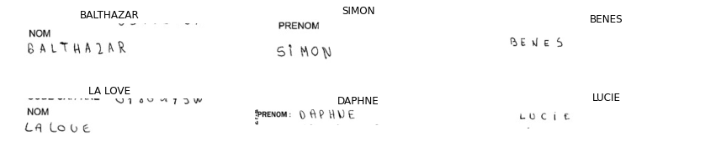
What data do we have ?
Sample 6 Images
Dataset Consists of 3.3 lakhs Images
1 lakhs unique labels
Handwritten Text Images
Inference:
Black and White Image
Characters are black
Characters are very thin
Image has some prefix like (Prenom and Nom (other than handwritten))

Slide 6
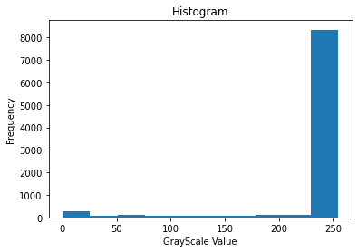
Visualize the Image Distribution
Histogram of a sample Image
Inference:
Pixel values are between 0 and 255
Towards zero (0) is black colour.
Foreground(Character) is black and very few pixels less than 1000) contribute to character.
Towards 255 is white colour.
Background is white and more than 8000 pixels contribute to background
In-between 0 and 255, all the pixels contribute noise to image

Slide 7
Pre-processing Dataset (Excel file)
Remove rows with No Labels (NaN) (Null Cells).
Remove rows that has labelled as ‘UNREADABLE’.
Convert all Labels to Upper Case Characters.
Map all characters to Numbers between 0 and 25 to construct the model easily.

Slide 8

Pre-process Image
Convert image to Grayscale(Black and White),
Make High contrast (Threshold and Invert). This makes the Image have more foreground pixels which makes the model predict easily.
Convert all the images to a fixed size (Height and Width). This makes the Input for the Model Uniform
Rotate Image to 90 degree. This makes the model predict the first character, first.
Before Pre-processing (Sample Image):
After Pre-processing Image (Sample Image)(Black Image) :

Slide 9
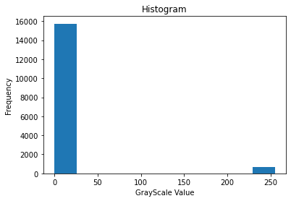
After Pre-processing, Histogram
Histogram of processed Sample Image.
The Noisy pixels are eliminated
by converting them either
to pure black or pure white pixels.
Now, White pixels are Characters.
Black pixels are Background.
The Number of Pixels that represent Character is increased to more than 1000 pixels from less than 1000 pixels. This makes the prediction more accurate.

Slide 10
Pipeline of Model
Pre-processed Image (Input)
Convolve Feature
Batch Normalization
RELU Activation
Max Pooling
Dropout 30%
Dense (Dimensionality Reduction)
LSTM
Dense
SoftMax Activation
CTC Loss (Output)

Slide 11
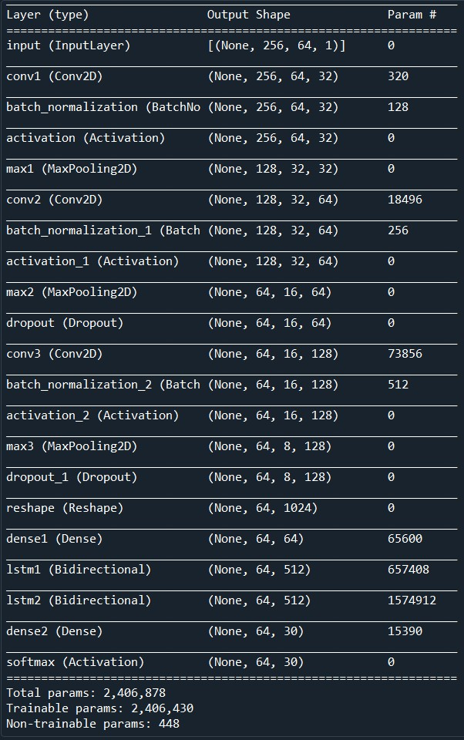
Summary of Model

Slide 12


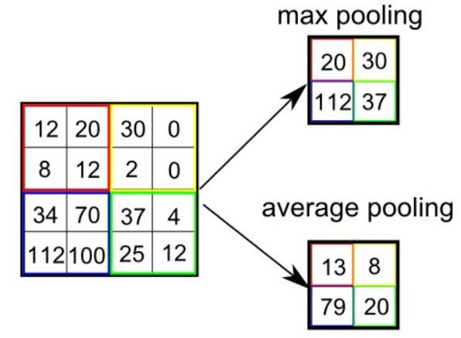
Convolution + Pooling Explained
Max Pooling
Convolution Filter
Convolution is a Feature Extraction process. They use Filter Kernels to extract important features in the image.
Pooling is a Dimensionality Reduction Process. It reduces the Dimension, yet conserving important features.
Here, a sample image is convolved and pooled for example.

Slide 13
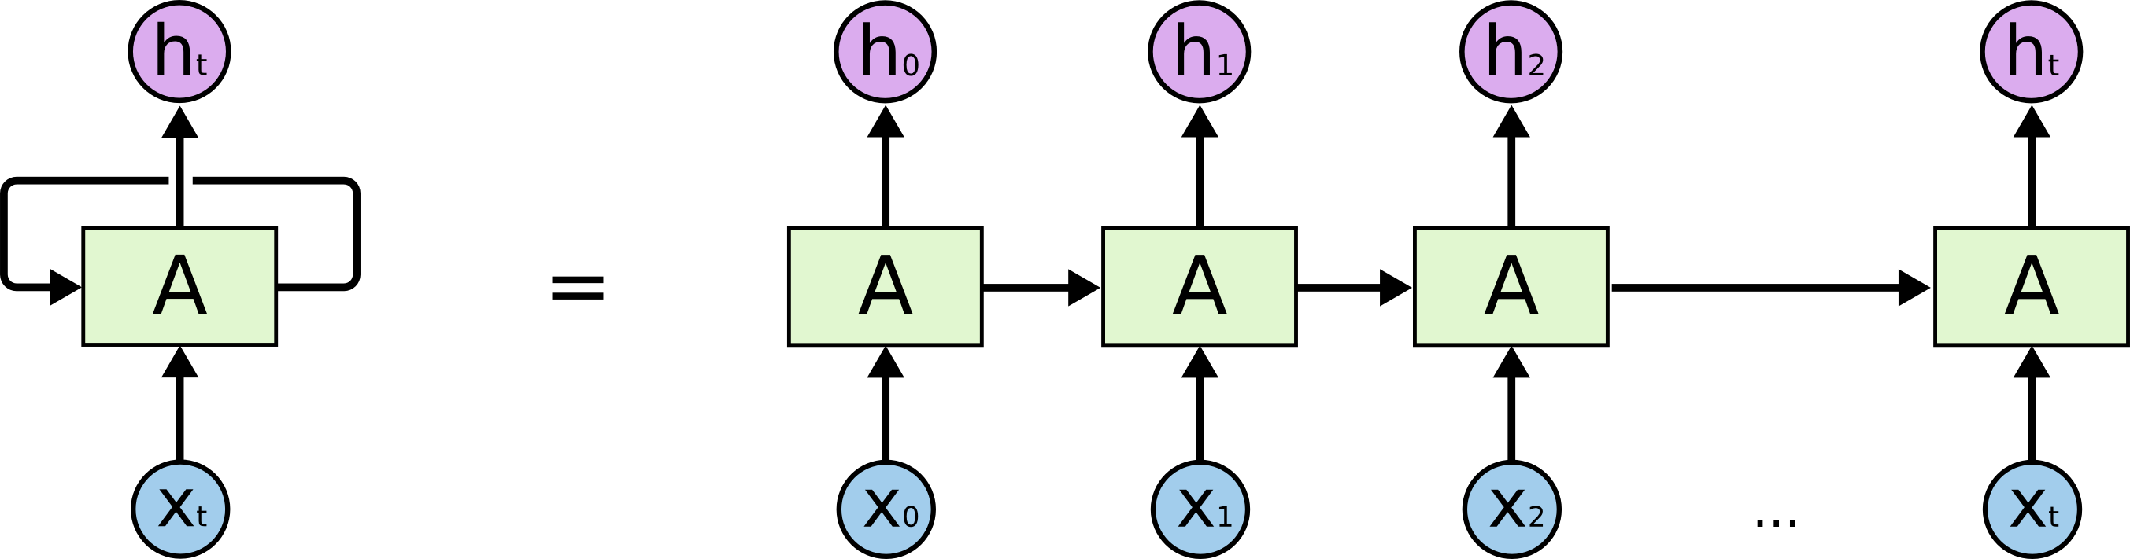
LSTM - RNN
LSTM - Long Short Term Memory - Recurrent Neural network
A RNN - multiple copies of the same network, each passing a message to a successor.
LSTM - capable of learning long-term dependencies.
Remembering information for long periods of time

Slide 14
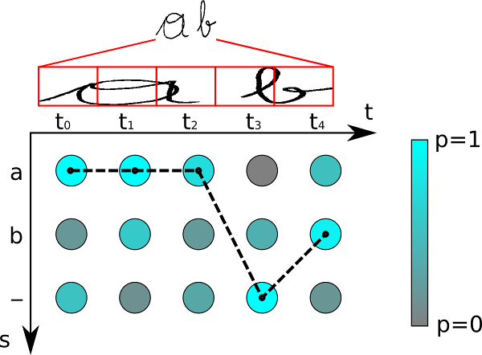
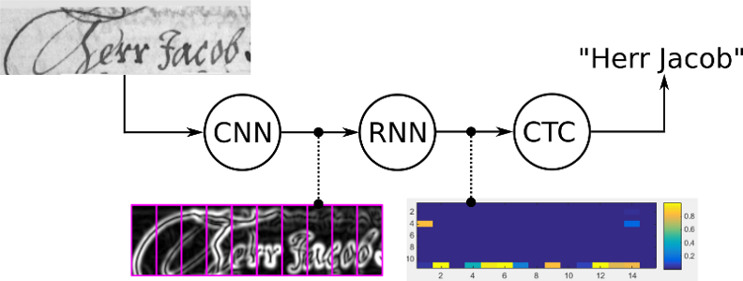
CTC Loss Output
CTC – Connectionist Temporal Classification
train: calculate the loss value to train the NN
infer: decode the matrix to get the text contained in the input image
we only have to tell the CTC loss function the text that occurs in the image. Therefore we ignore both the position and width of the characters in the image.

Slide 15
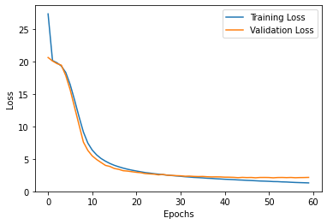
Evaluation of CRNN Model
Fitted – with 30K Images.
It took nearly 5 hours to train the model.
60 epochs , each 30K images.
Made use of GPU for Image processing.
Tested with 3K Images.
Without High Contrast, the model gave an accuracy of 85% of character prediction accuracy
With using High Contrast colours, it gave 91% character prediction accuracy

Slide 16
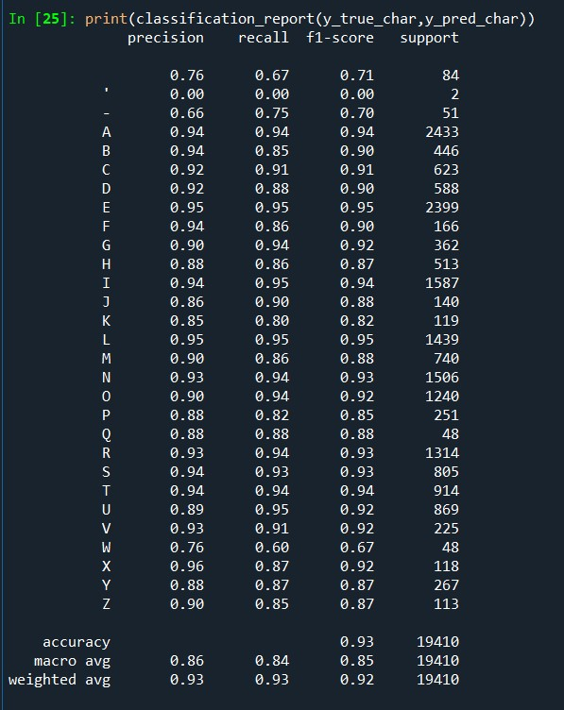
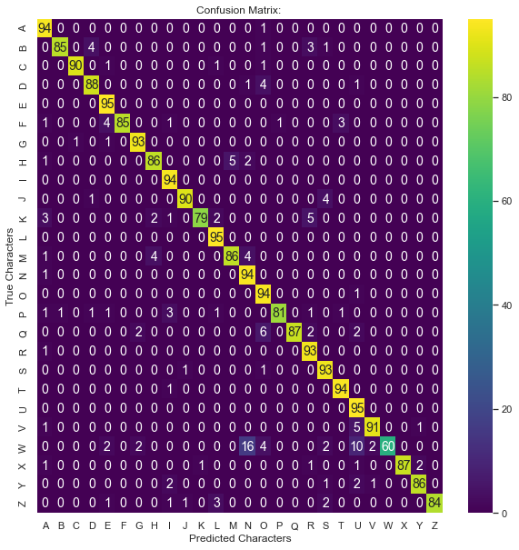

Classification Report (3000 Images)

Slide 17
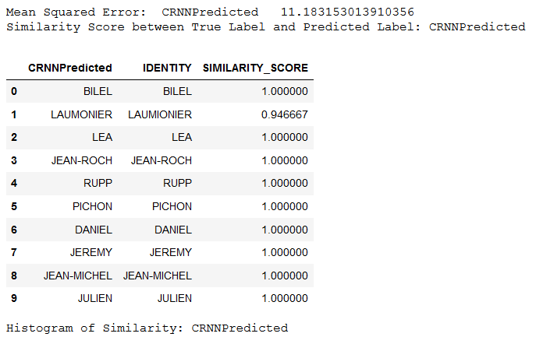
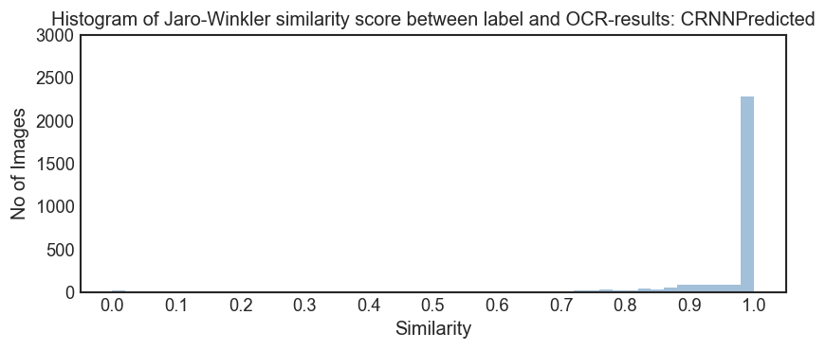
Similarity, Error Metrics

Slide 18
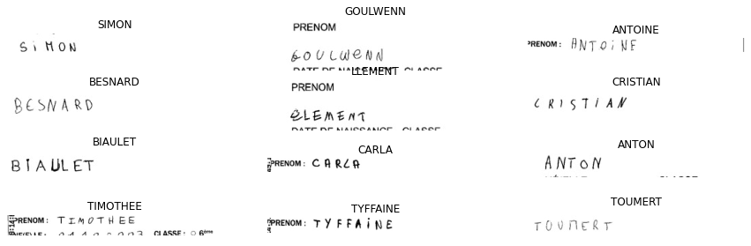
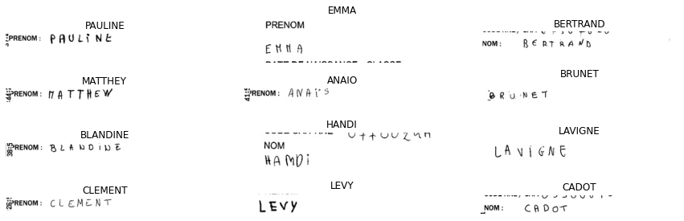
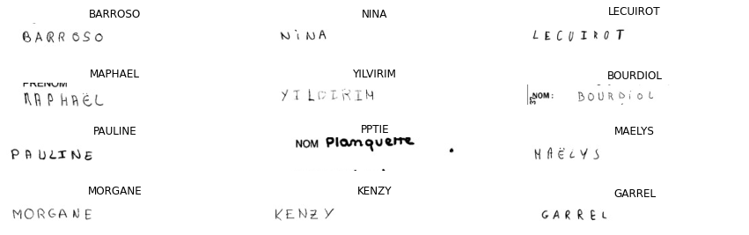
Sample Predicted Output

Slide 19
Comparison (RNN vs CNN vs CRNN)
Likewise, Created RNN Model, CNN Model (Individually).
Trained all these three models with same 30K images.
Tested it on 3.3 Lakhs Images.

Slide 20
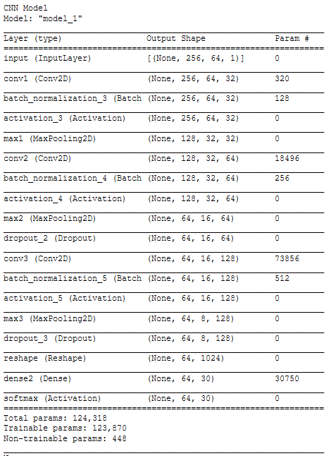
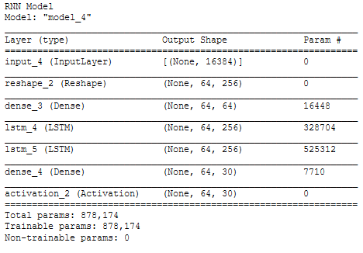
How do these models(CNN,RNN) look like ?

Slide 21
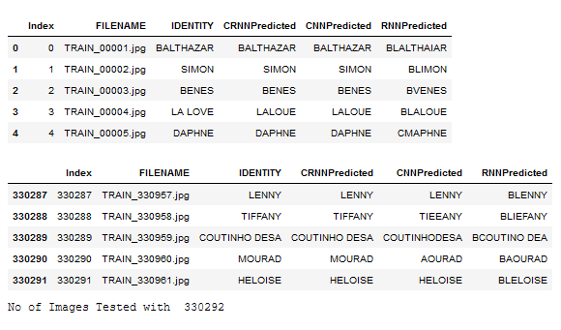
How do the predictions look like?

Slide 22
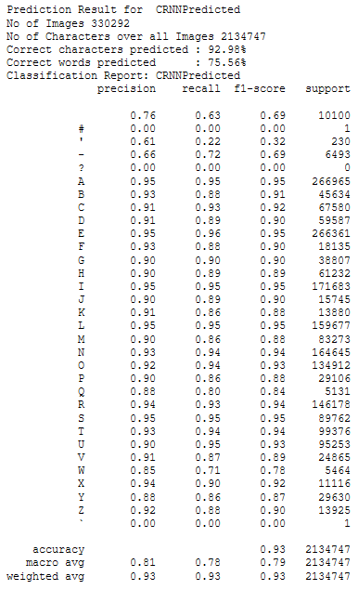
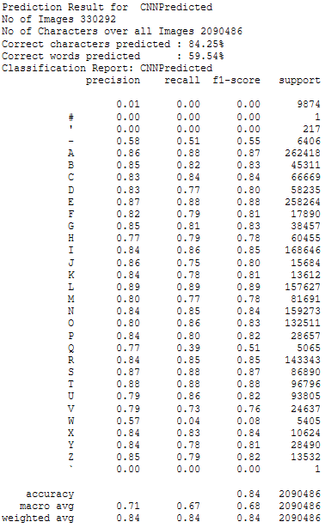
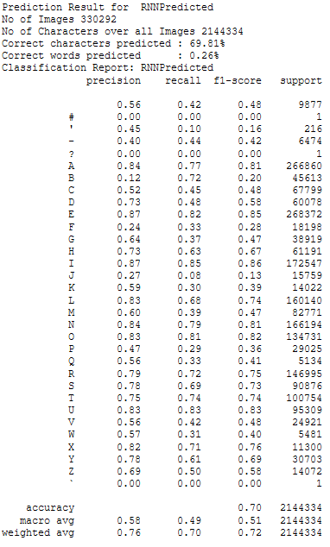
What have we found in the Comparison ?

Slide 23
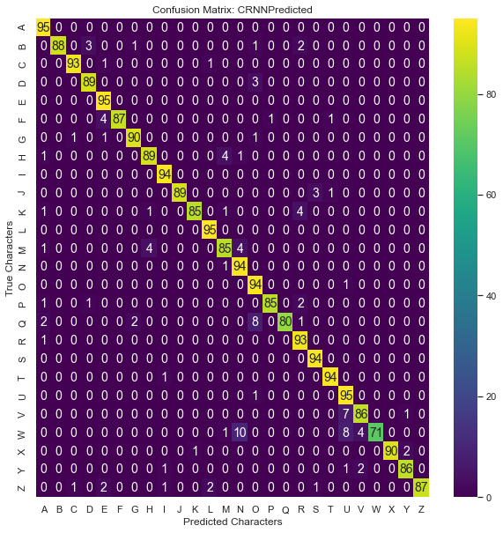
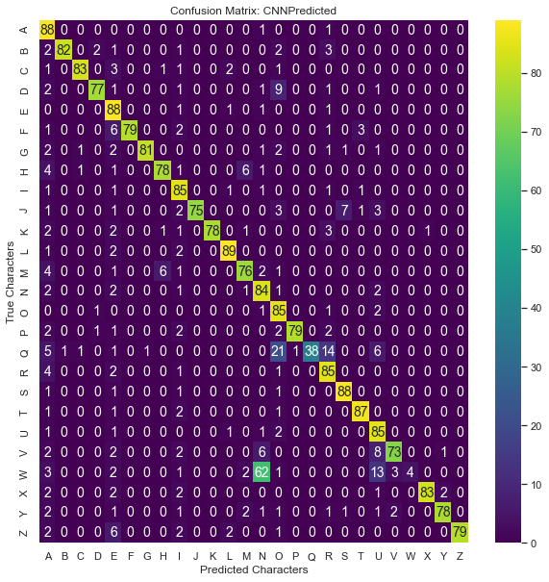
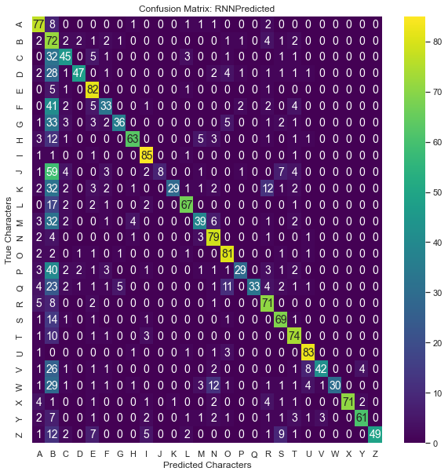
Confusion Matrix

Slide 24
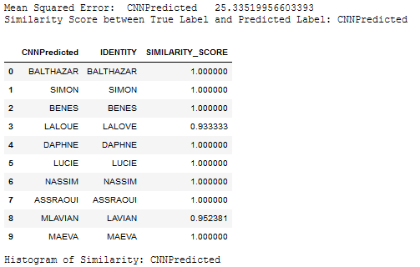
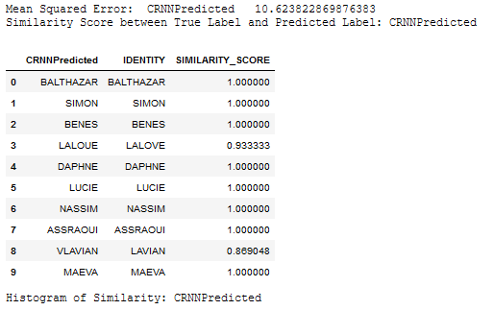
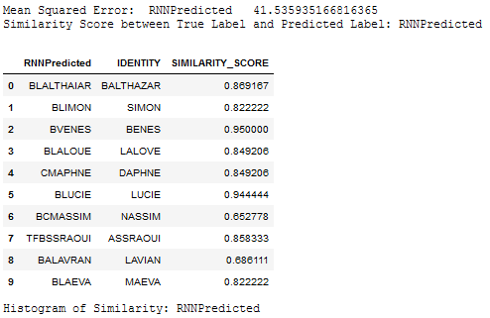
Loss & Similarity

Slide 25
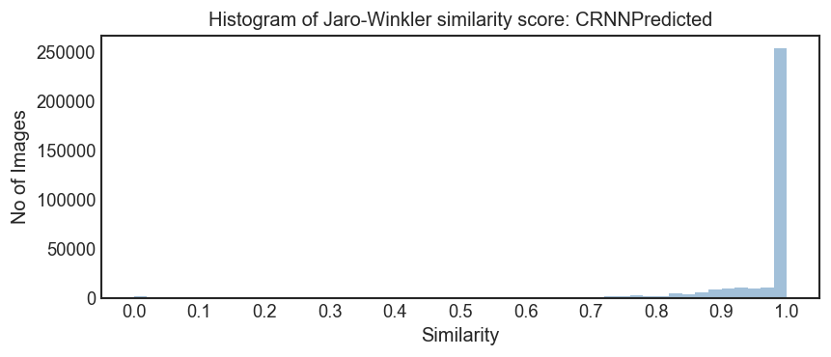

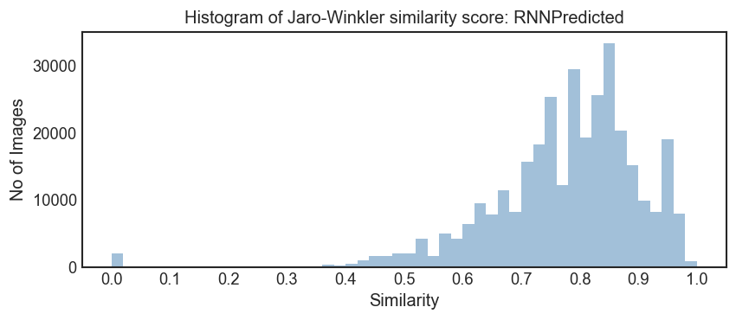
Histogram of Similarity

Slide 26
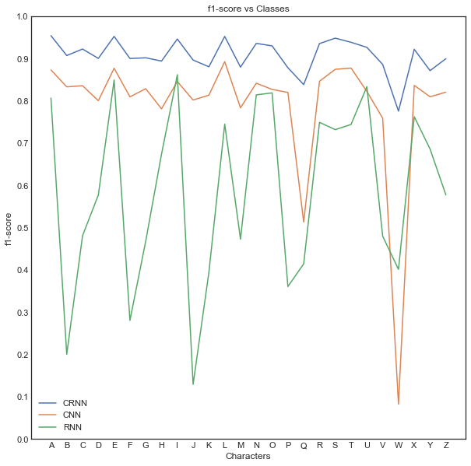
F1-score Plot

Slide 27
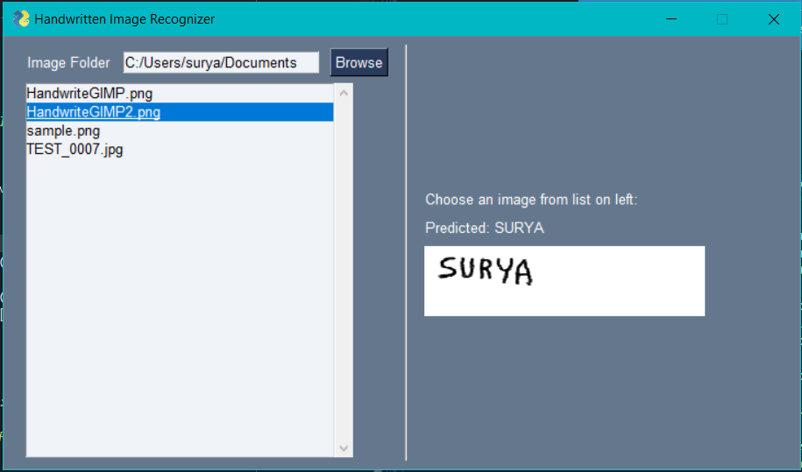
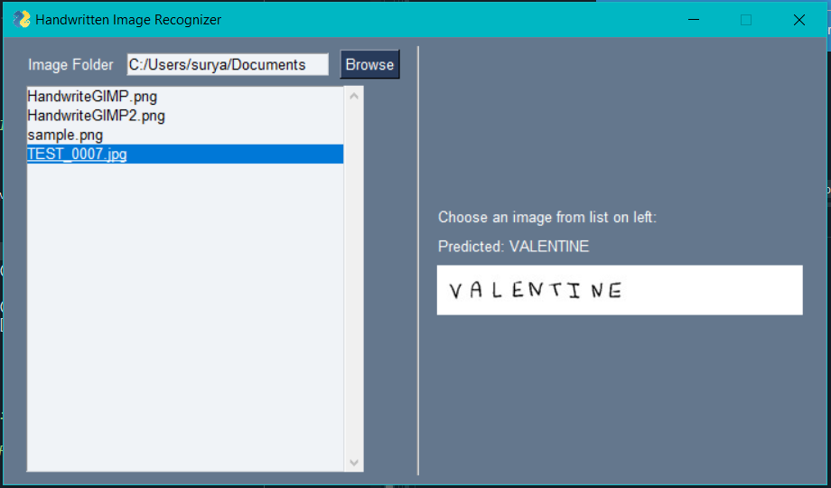
Handwritten Image Recognizer (GUI)

Slide 28
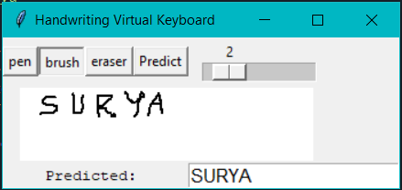
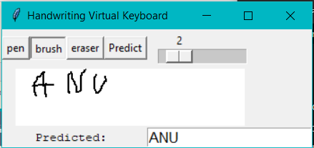
Handwriting Virtual Keyboard (GUI)

Slide 29
Conclusion
Hence, it is concluded that CRNN performs better than CNN & RNN.
Pre-processing has effects on prediction.
Choosing a proper model layers has its effects on prediction.
Fitting(Training) of images has its effects. (Over fitting etc).
Plot Evaluation of Prediction gives more information.
Two GUI is built for use with the best model (CRNN) found.

Slide 30
References
https://towardsdatascience.com/a-comprehensive-guide-to-convolutional-neural-networks-the-eli5-way-3bd2b1164a53
https://colah.github.io/posts/2015-08-Understanding-LSTMs/
https://towardsdatascience.com/intuitively-understanding-connectionist-temporal-classification-3797e43a86c
https://www.kaggle.com/landlord/handwriting-recognition

Slide 31
Thank You

